Slide 1

TRENDCART
WELCOME

Slide 2

UKA TARSADIA UNIVERSITY
For Partial fulfillment of the requirements
For the degree of Bachelor of Computer Application
B.V. Patel Institute of Computer Science,
Uka Tarsadia University.
December, 2024

Slide 3
Team Number
BCA5_B18
Presented by
202203100110084 : Sakshi Shah
202203100110088 : Marmik Vajir
202203100110108 : Tirth Pandya
202203100110160 : Mavani Krishnkumar
Project Guide
Ms. Mubashshirahbanu Shekh

Slide 4
Chapter 1 : Introduction
Objective & Definition
Functional Requirements
Non-Functional Requirements
Tools and Technology

Slide 5
Definition :-
TrendCart connects customers and vendors, offering a wide range of footwear from shoes to flip-flops. Customers can explore quality products, while vendors manage inventory and sales easily.
With free product promotion and no hidden charges but just a small fee. TrendCart empowers businesses to grow effortlessly.

Slide 6
Functional Requirements
Admin
Login
Manage Categories
Manage Brands
Products Verification
Vendors Verification
Report Generation
View Feedback
Payment verification
Logout

Slide 7
Vendor
Registration
Login
Manage Profile
Manage Product
Payment Details
Report Generation
Contact Us
FAQ
Logout

Slide 8
Customer
Customer Registration
Login
Filter product
Product Visualization
Wishlist (Add to Cart)
Buy Product
Payment Gateway
Feedback
Contact Us
Logout

Slide 9
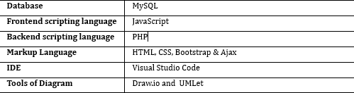
Non-Functional Requirements
Security
Tools & Technology

Slide 10
Chapter 2 : Proposed System
Purpose
Scope
User of the System

Slide 11
Purpose
To provide customers with a convenient and seamless platform for purchasing and explore wide variety and diverse range of footwear online, making shopping convenient and enjoyable.
Scope
Footwear products only will be sold on the System (TrendCart) and a vendor can sell footwear products only. Exceptional products will not be accepted by the side of vendor. The System will cater exclusively to customers within surat city.

Slide 12
User of the System
U
Admin
Vendor
Customer

Slide 13
Chapter 3 : Database Design
Use case Diagram
Activity Diagram
Data Dictionary with Constraints

Slide 14
Use case Diagram

Slide 15
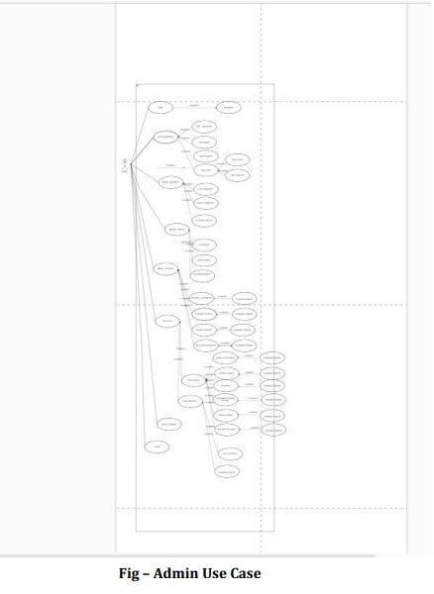
Use case Diagram
Admin

Slide 16
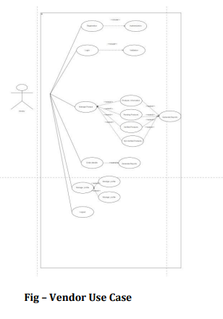
Use case Diagram
Admin
Vendor

Slide 17
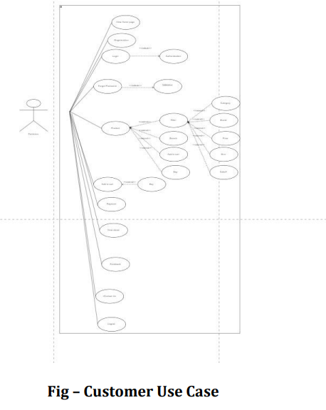
Use Case Diagram
Admin
Vendor
Customer

Slide 18
Activity Diagram

Slide 19
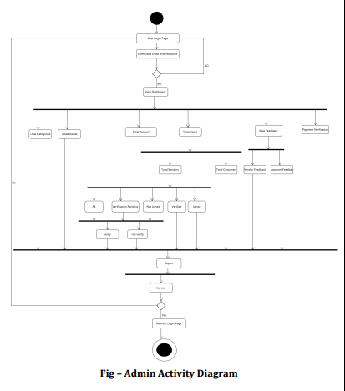
Activity Diagram

Slide 20
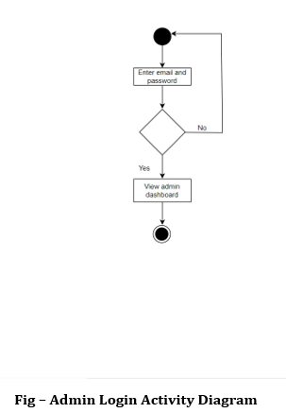
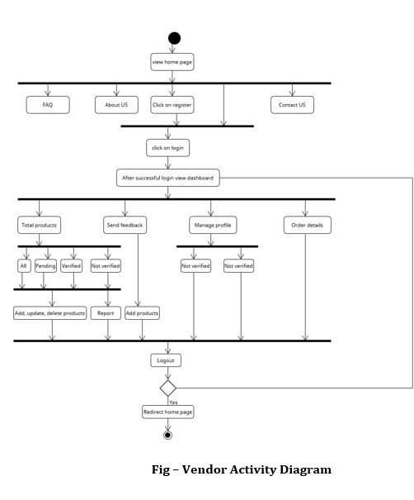

Slide 21
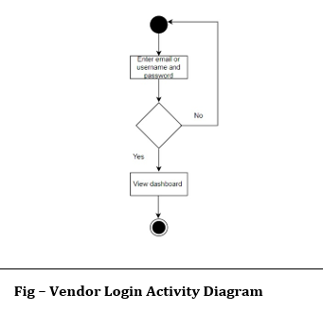
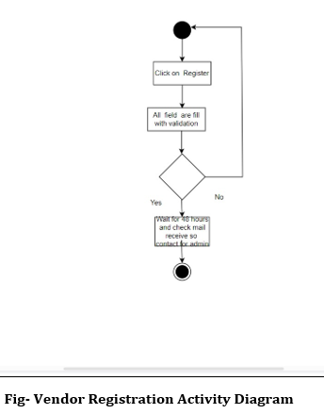

Slide 22
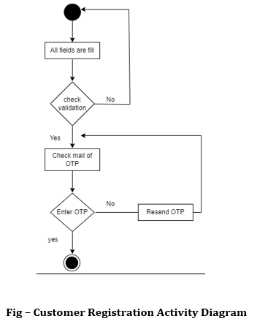
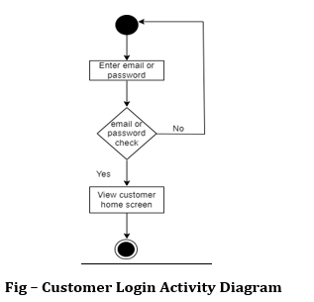

Slide 23
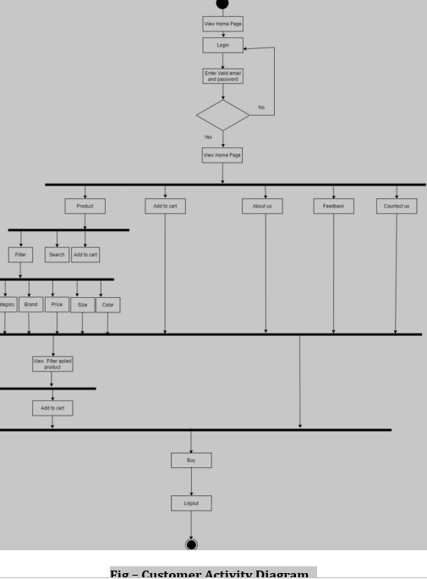
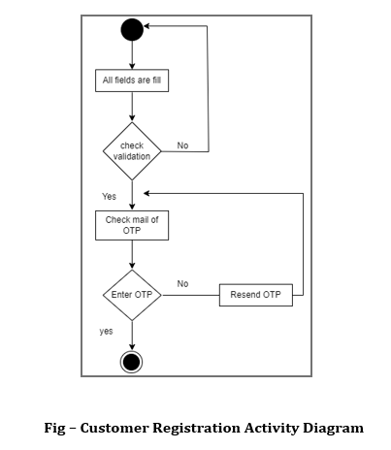

Slide 24
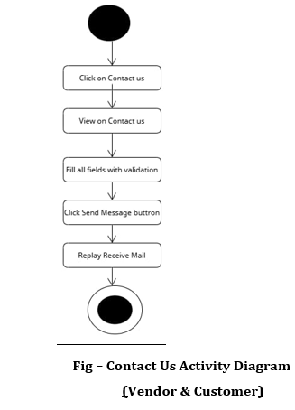
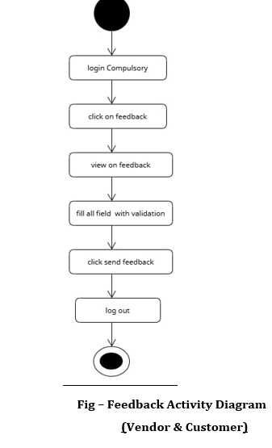

Slide 25
Data Dictionary with Constraints

Slide 26
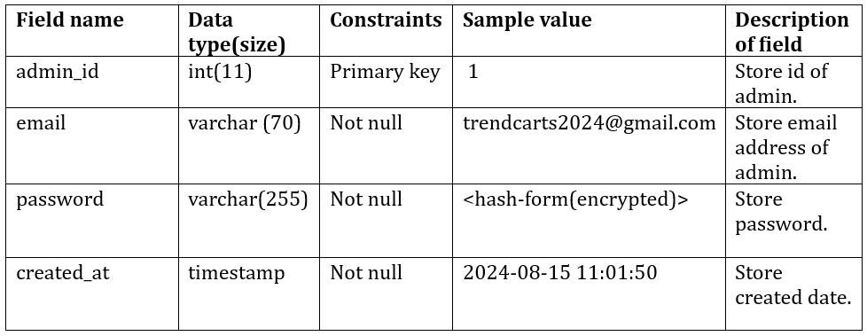
admin

Slide 27
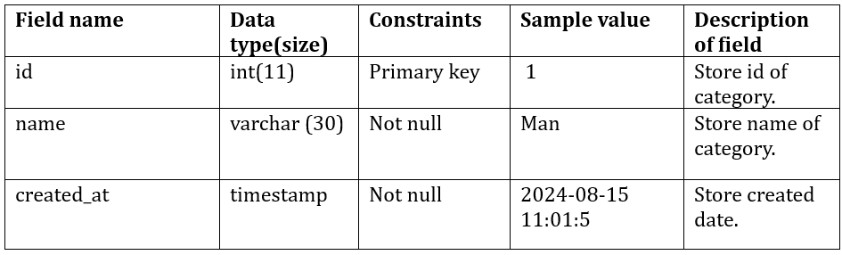
categories

Slide 28
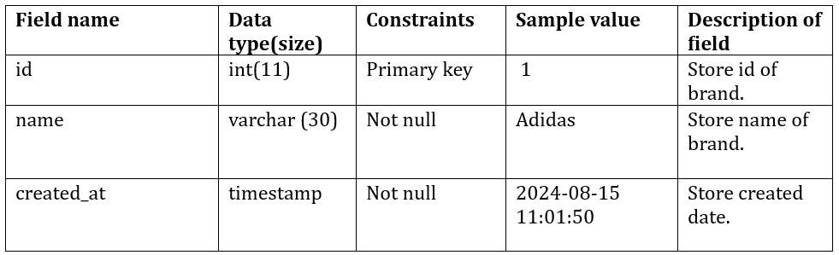
brands

Slide 29
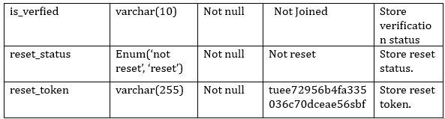
vendors

Slide 30
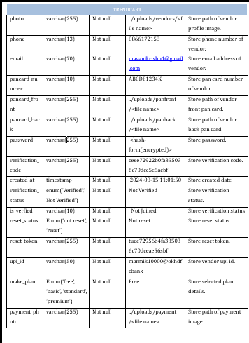

Slide 31
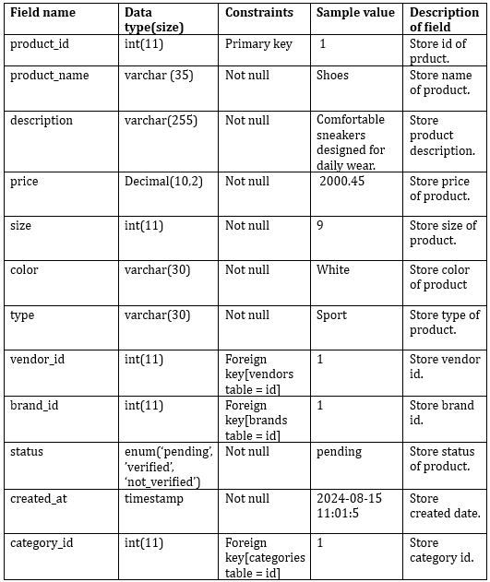
Product

Slide 32
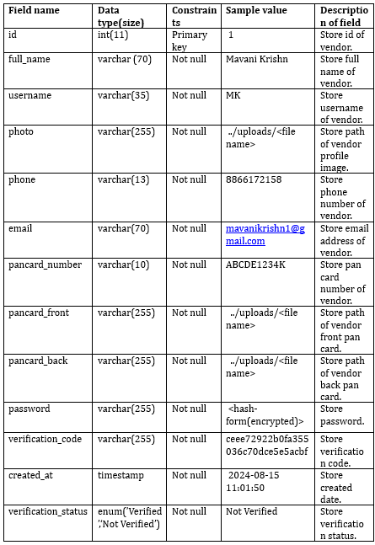
vendors

Slide 33
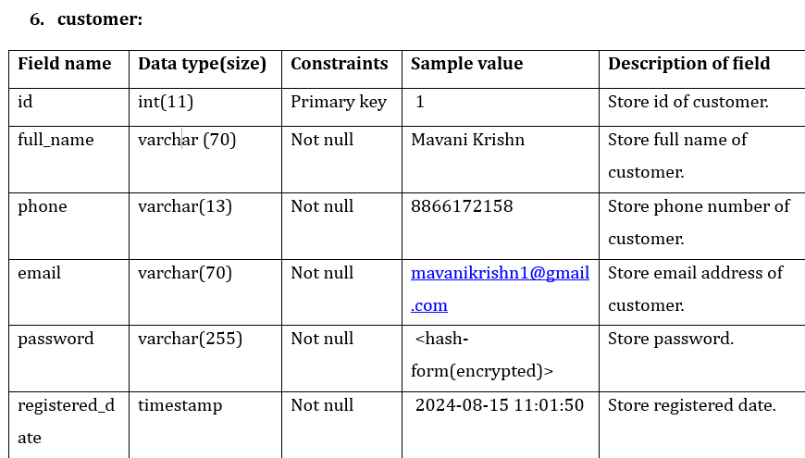
Customer

Slide 34
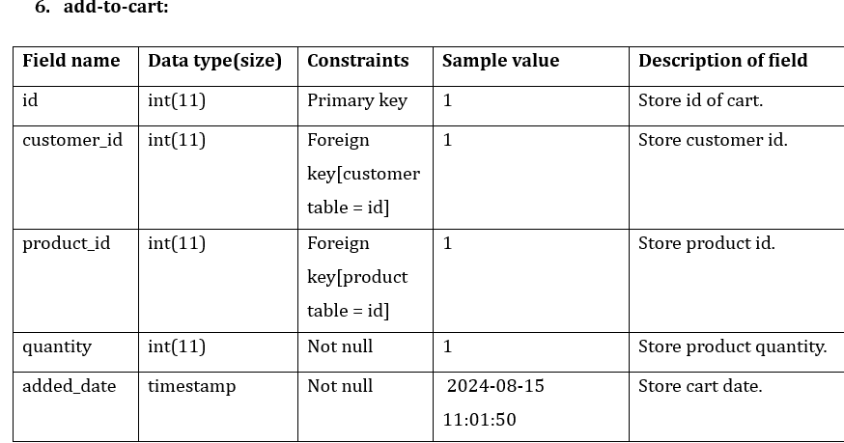
Add to cart

Slide 35
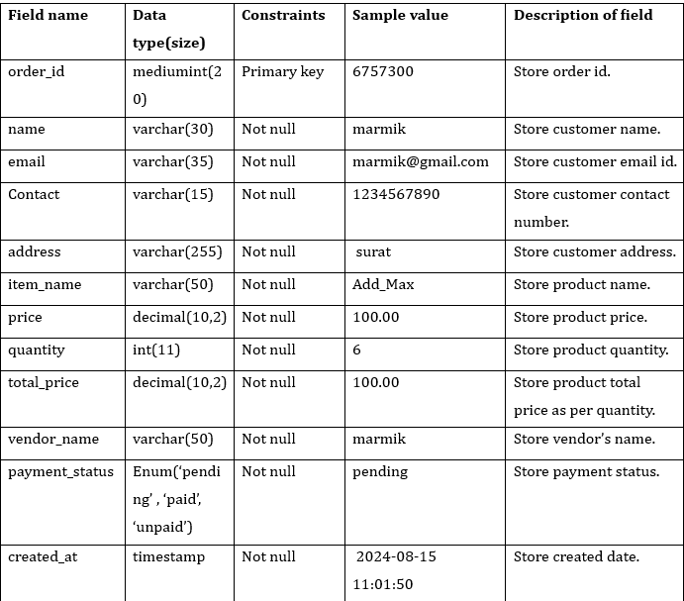
Customer order-info

Slide 36
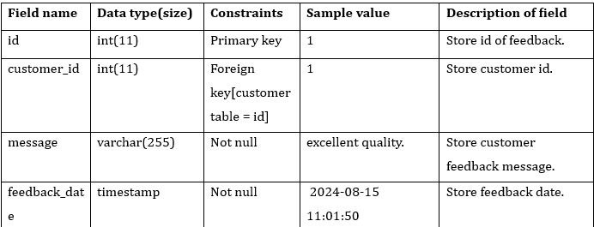
feedback

Slide 37
Chapter 4 : User Interface Design
Screenshot of UI

Slide 38
Screenshot of UI

Slide 39
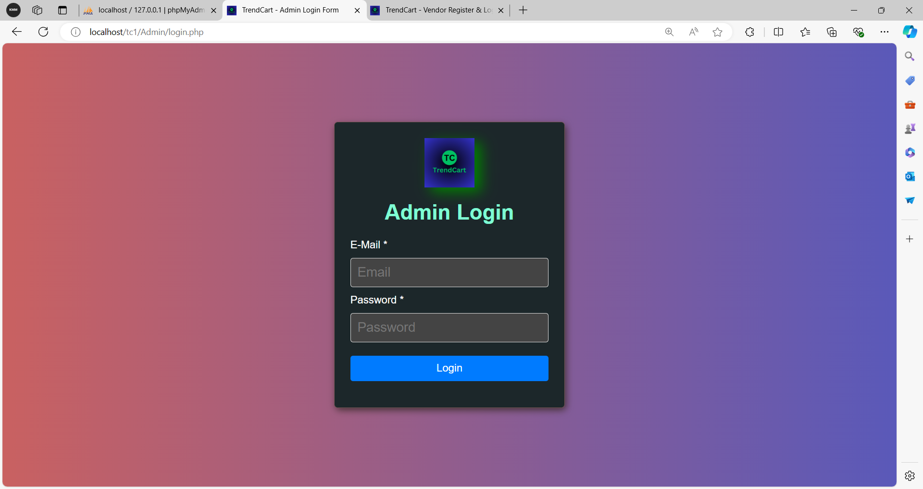
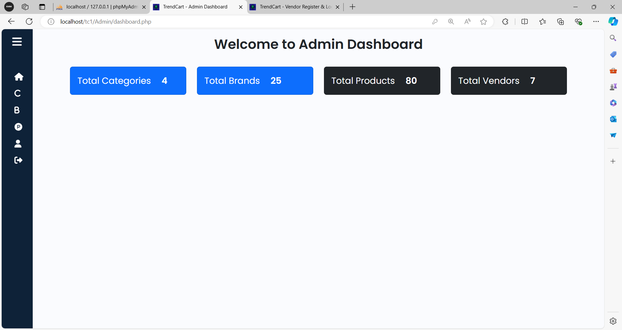
Admin Login
Admin Dashboard

Slide 40
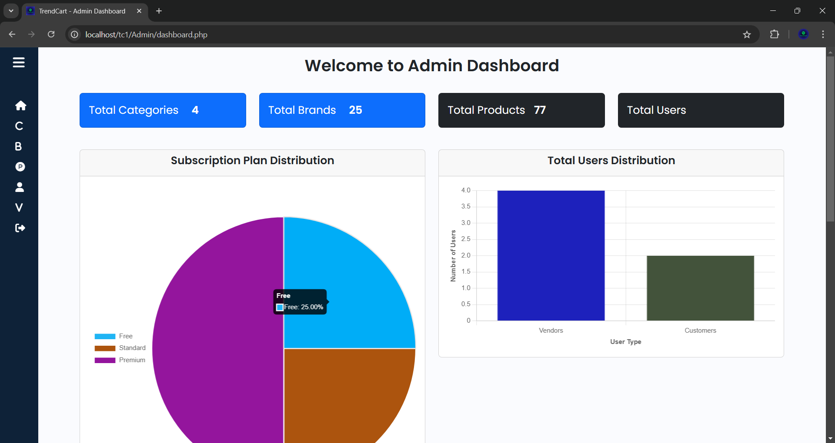
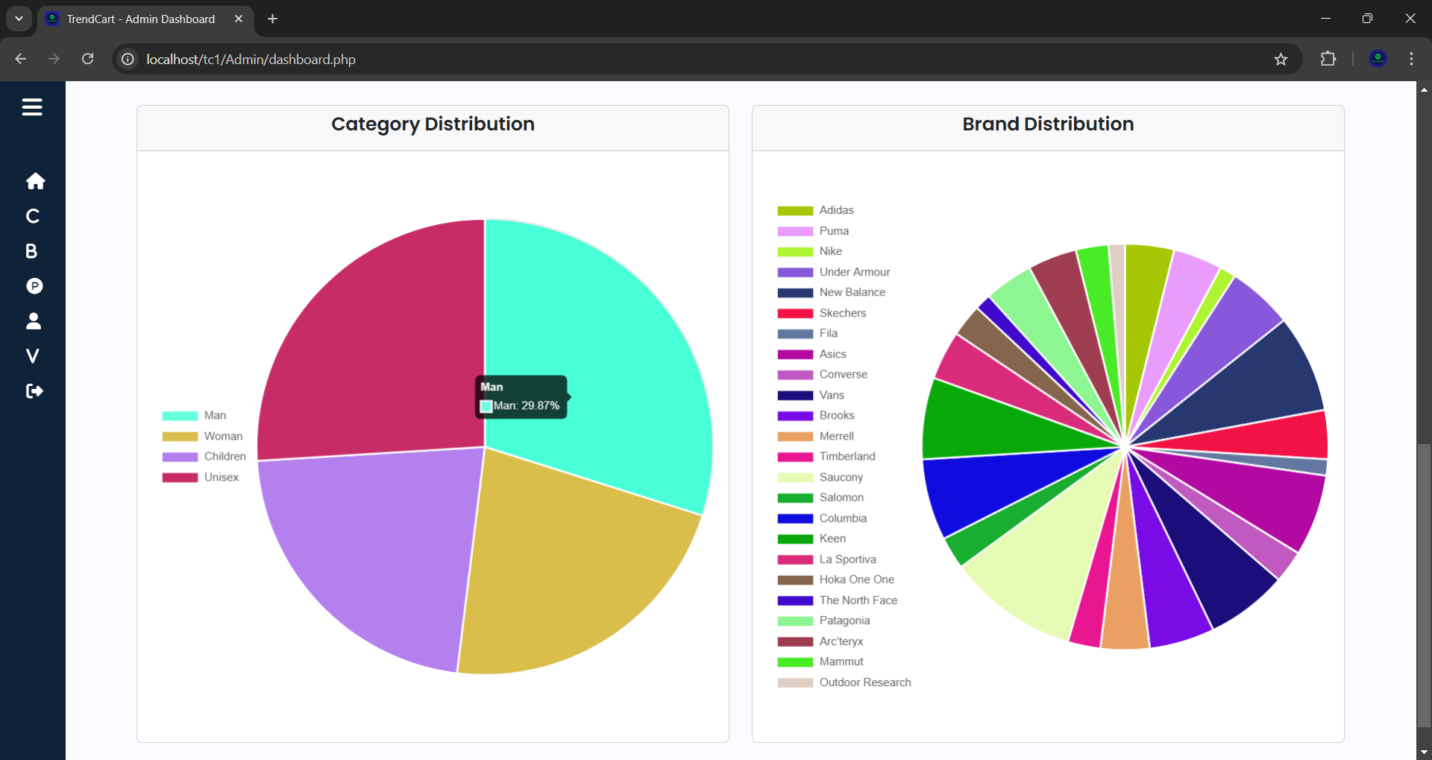

Slide 41
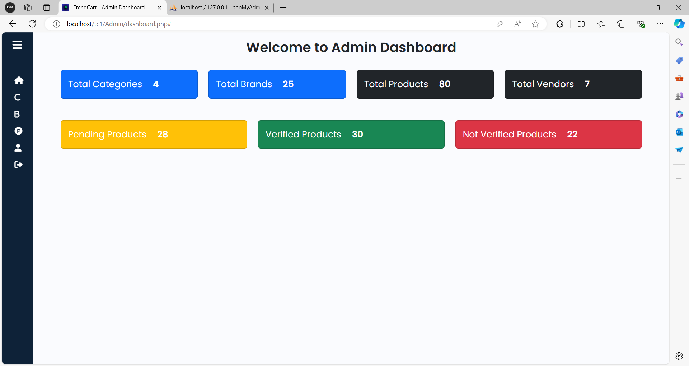
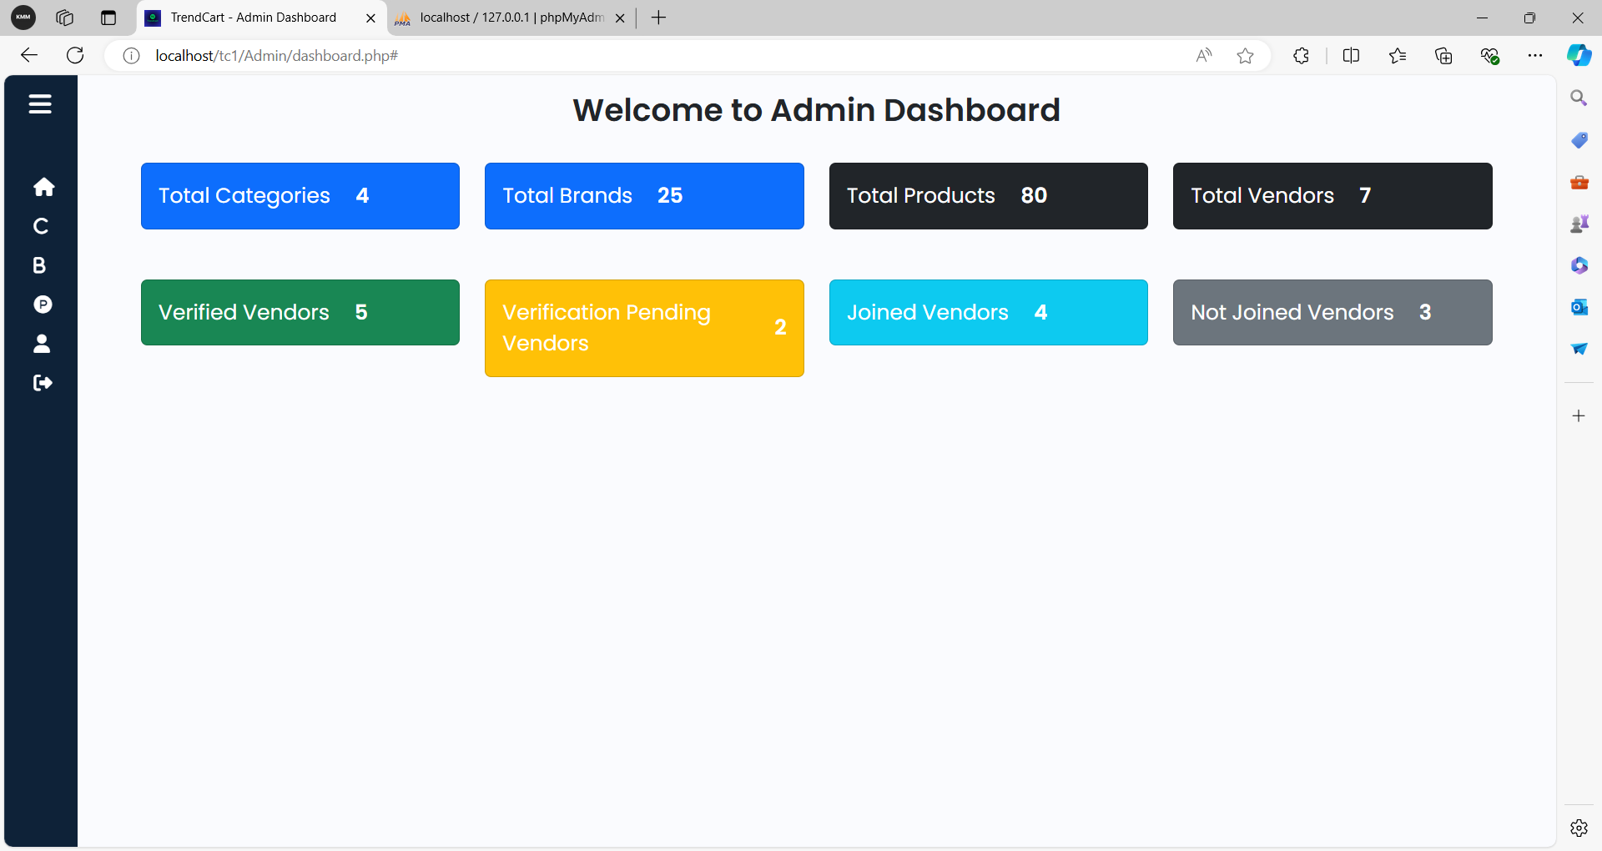
Admin Dashboard

Slide 42
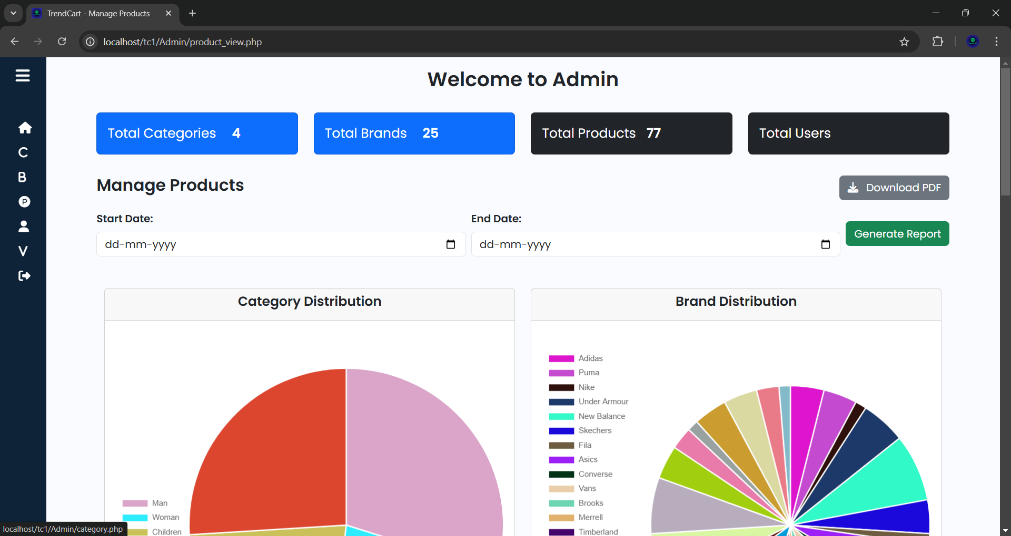
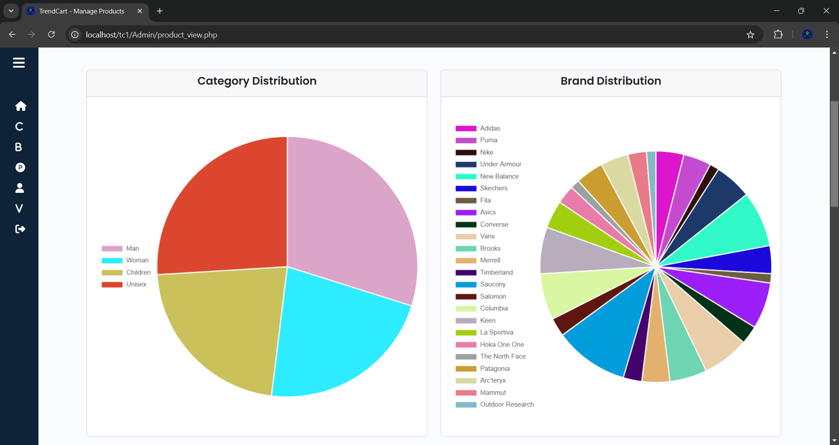

Slide 43
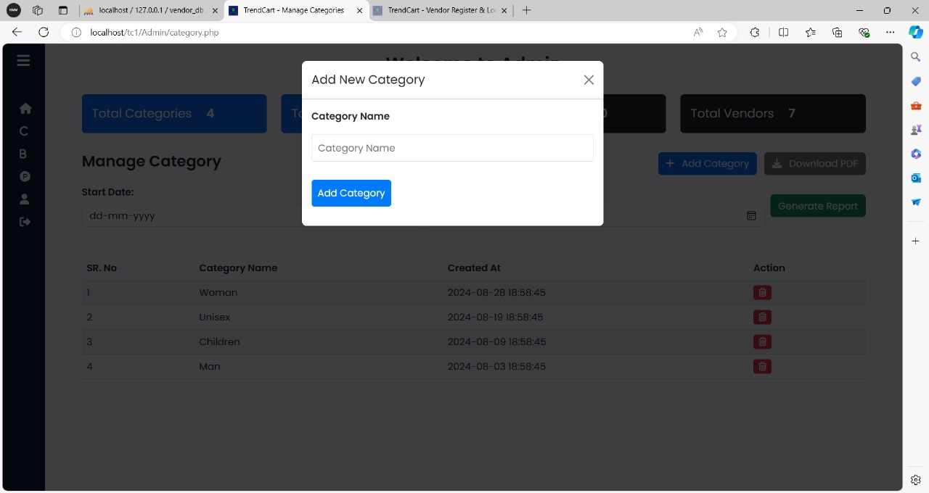
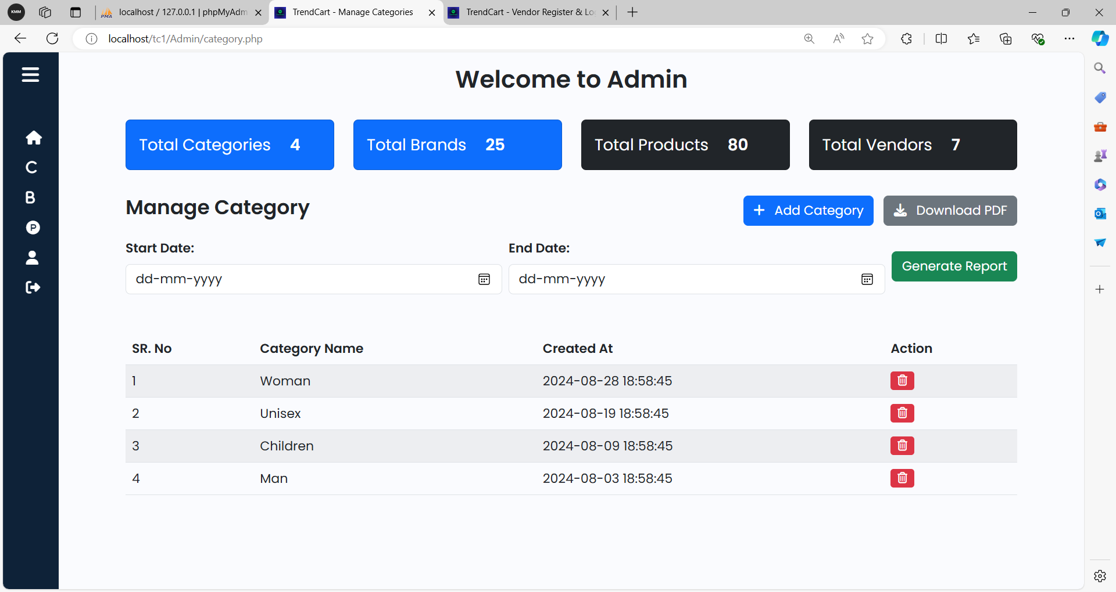
Add Category
Manage Category

Slide 44
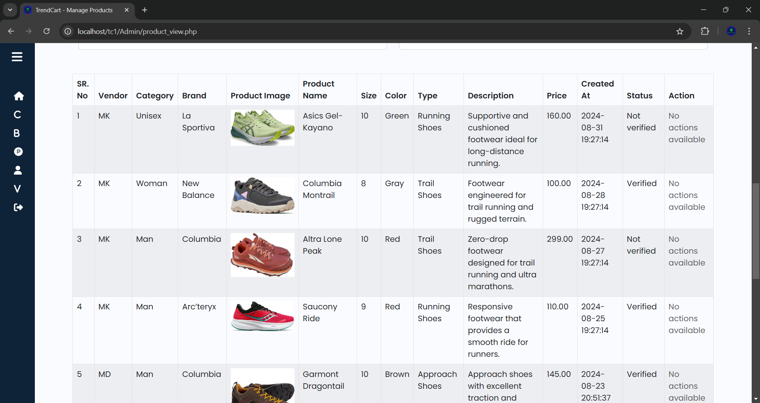

Slide 45
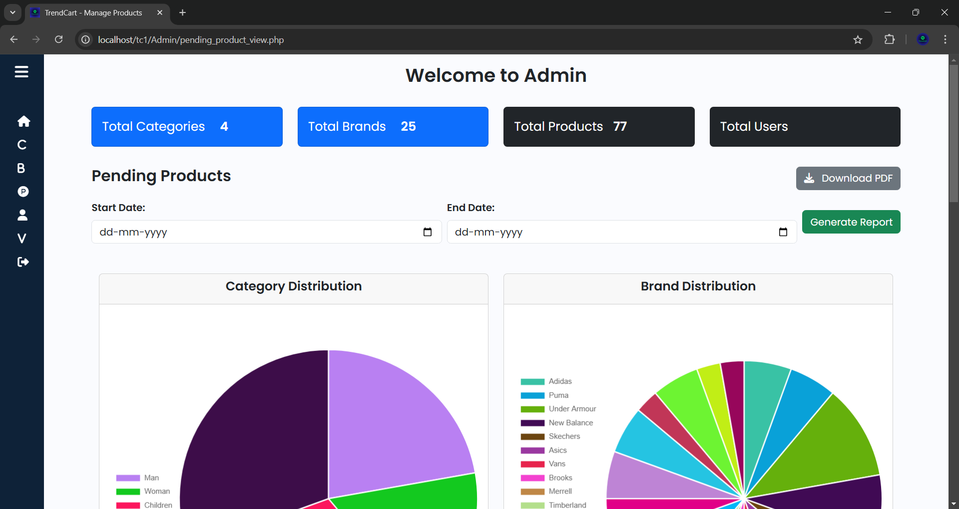
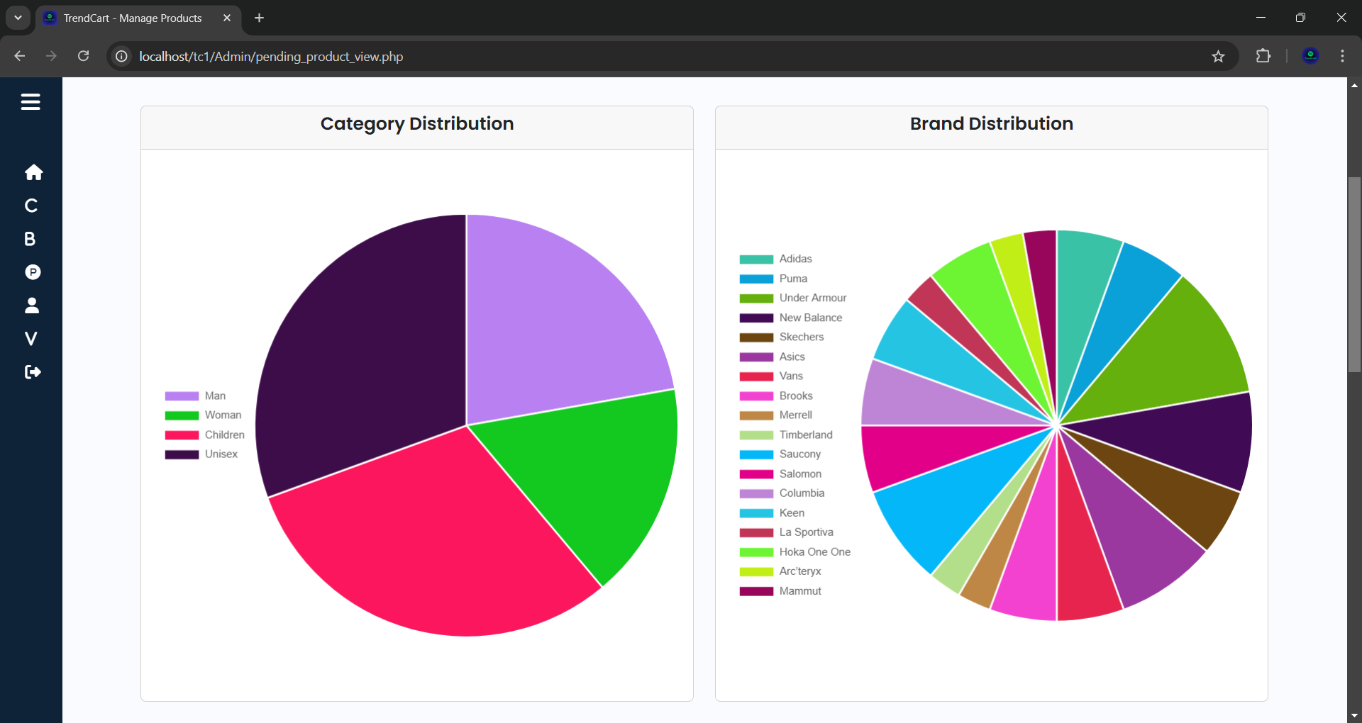

Slide 46
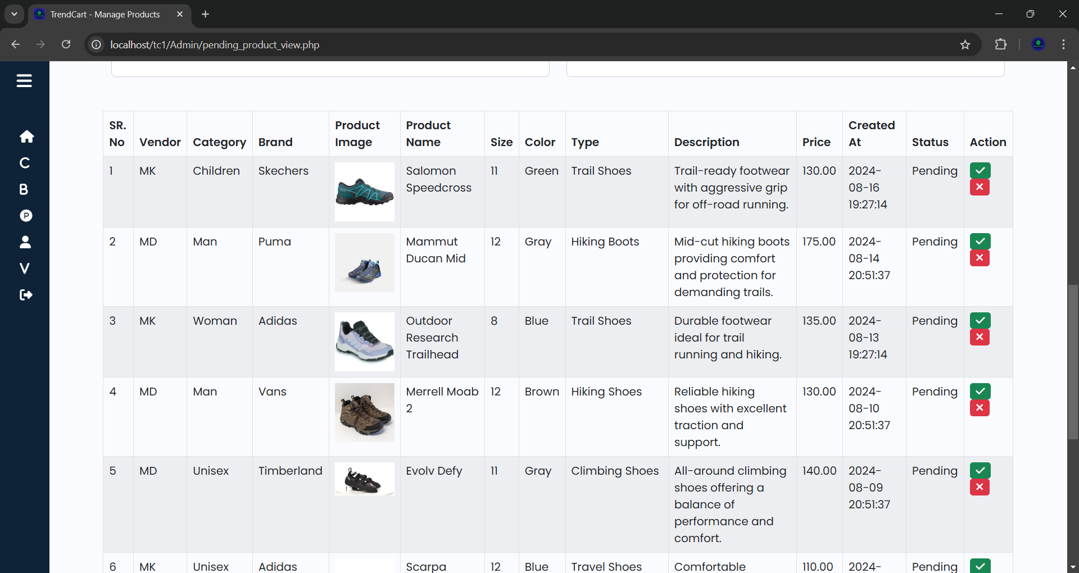
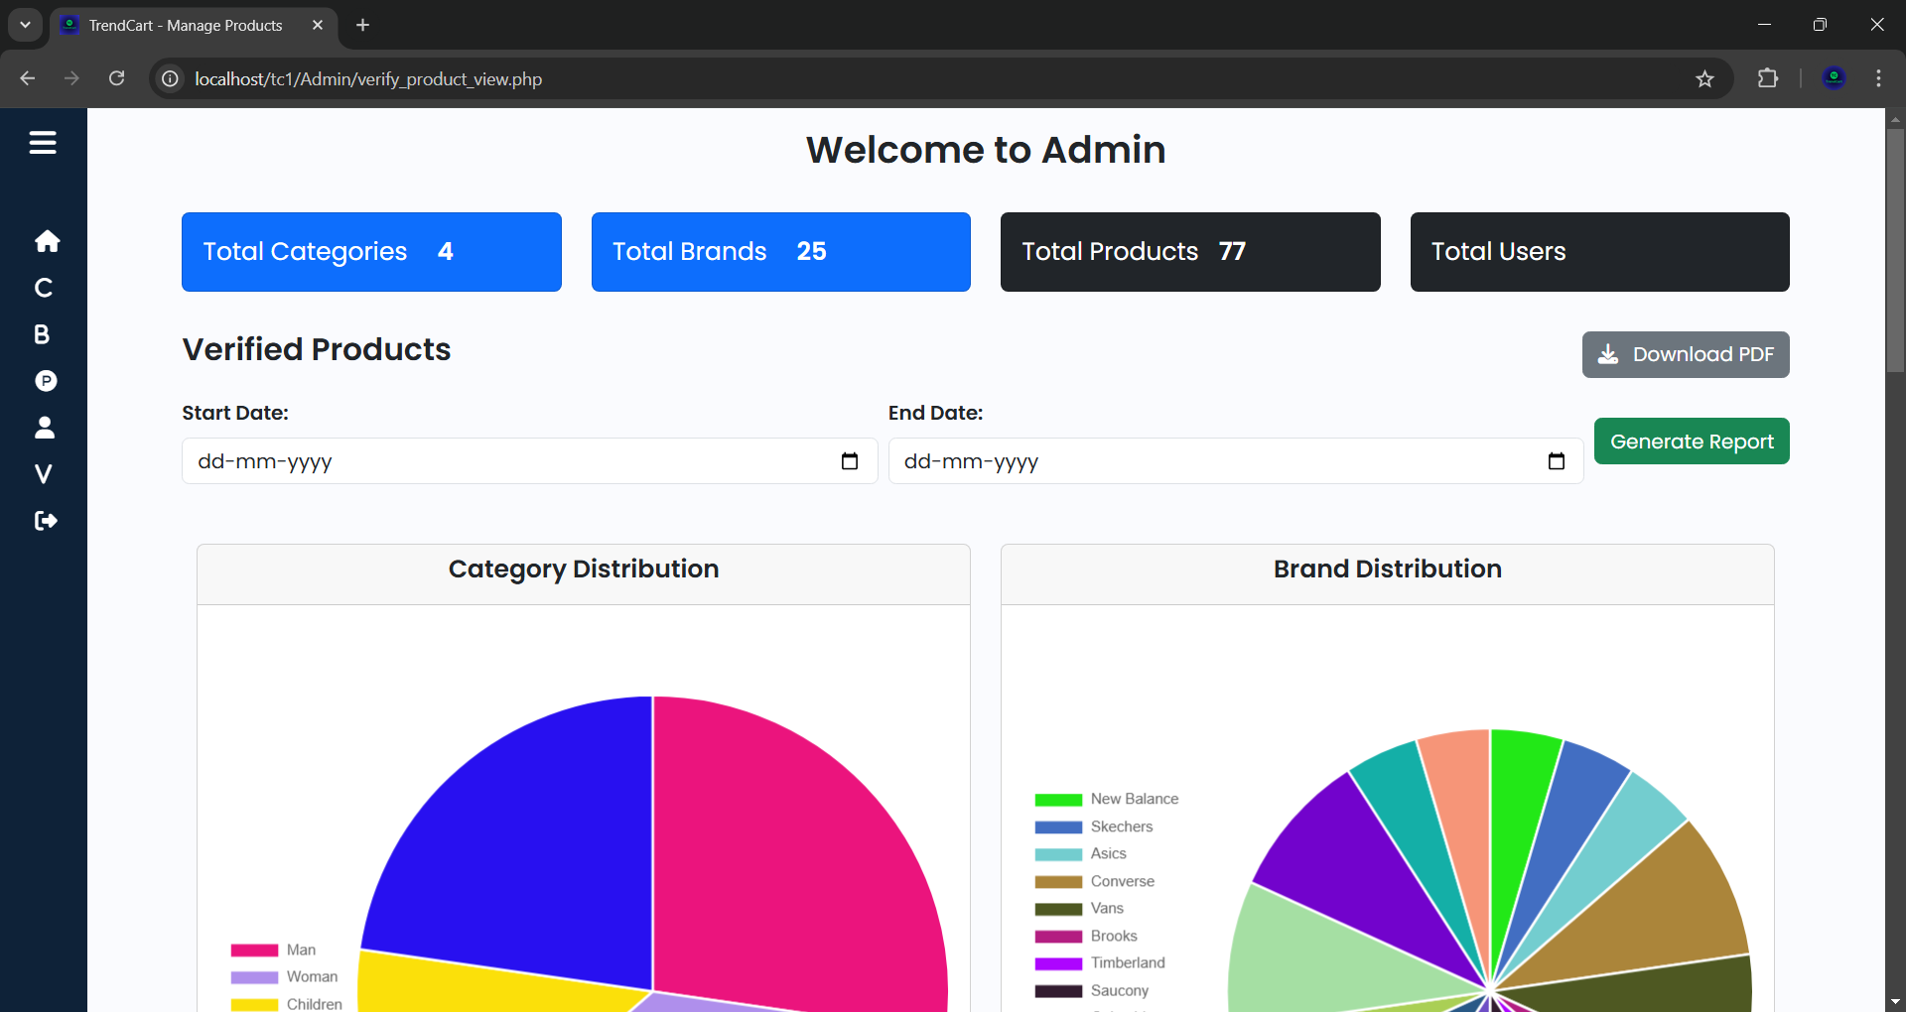

Slide 47
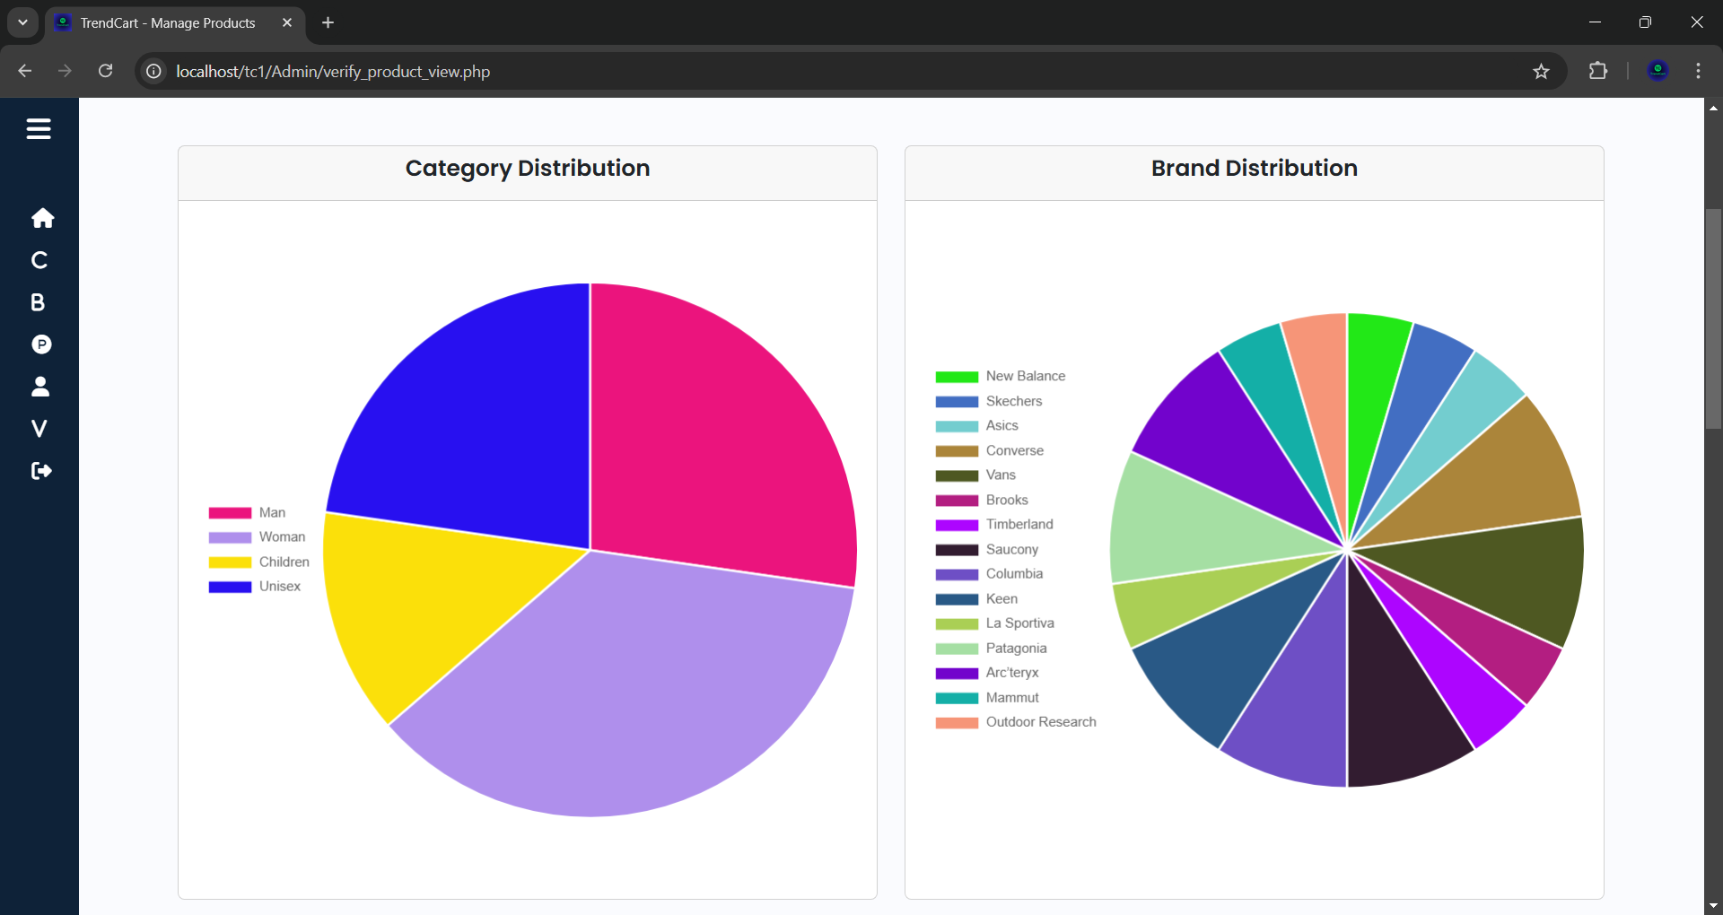
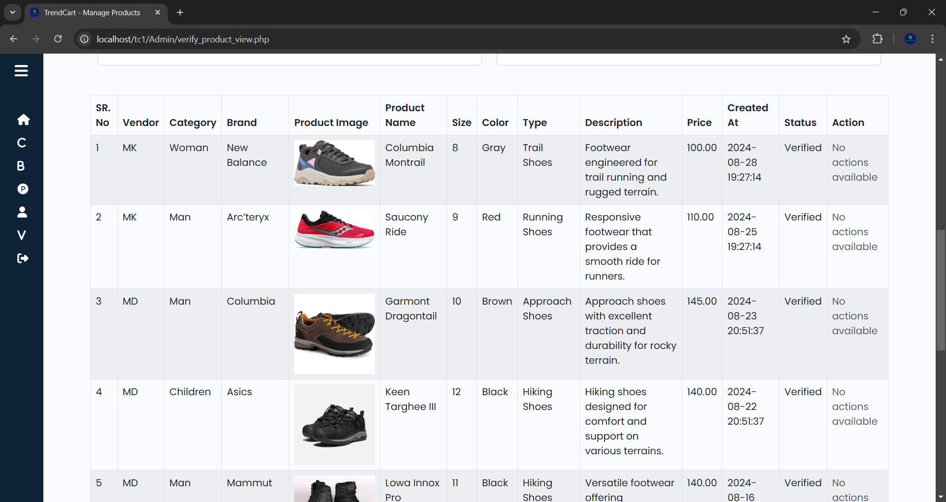

Slide 48
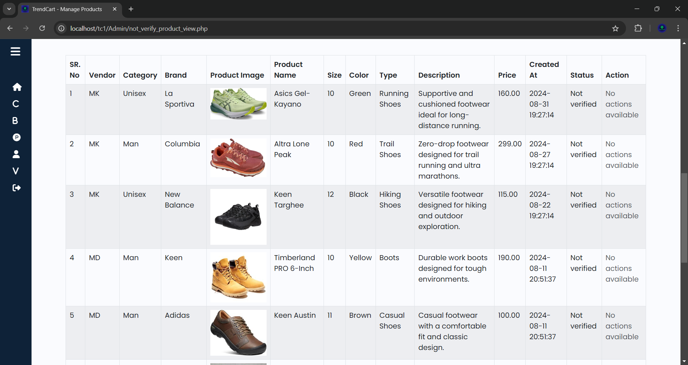
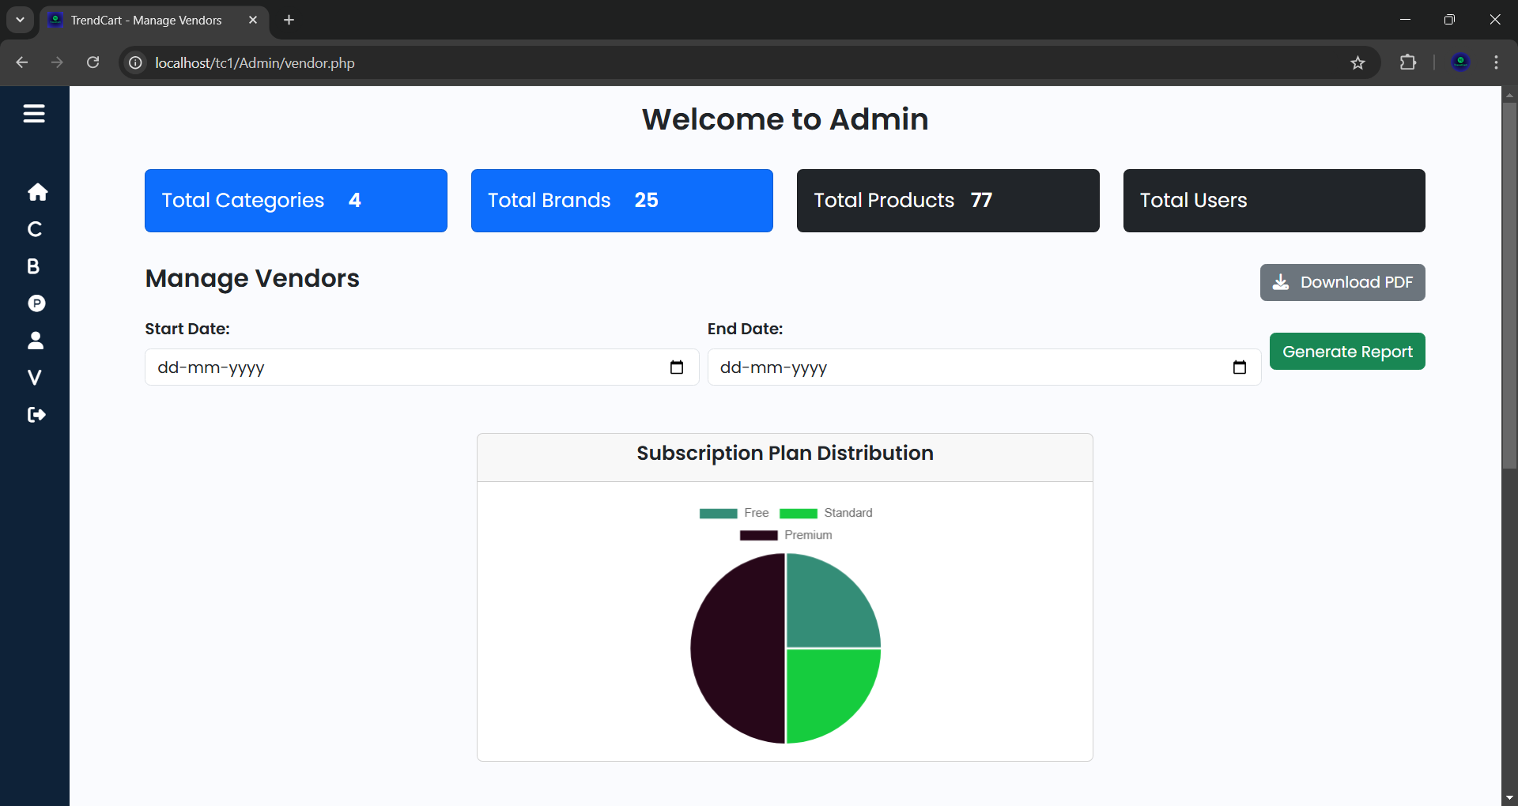

Slide 49
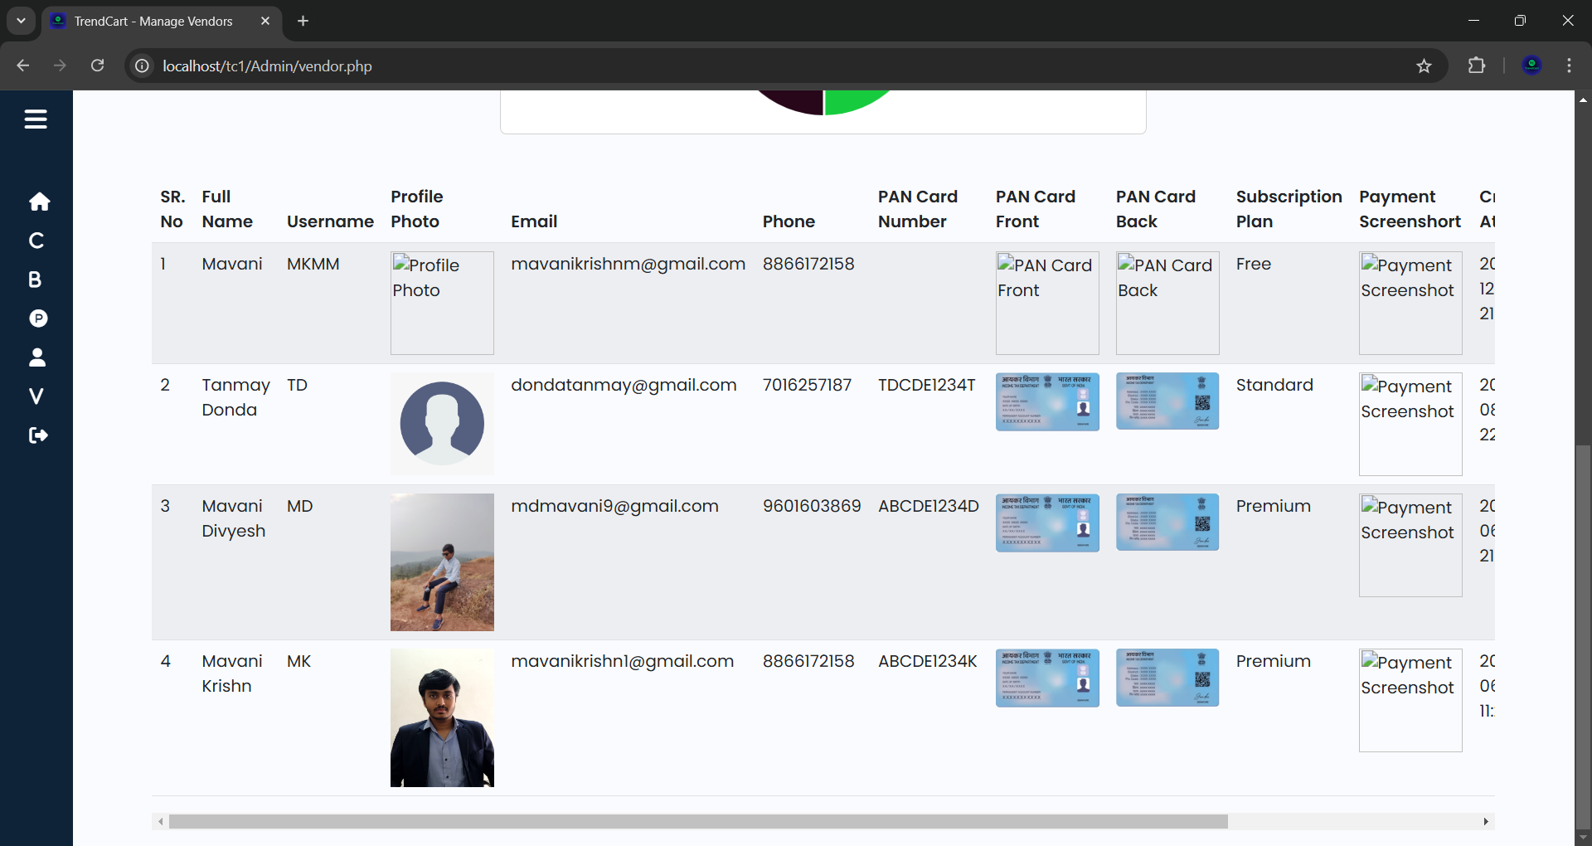
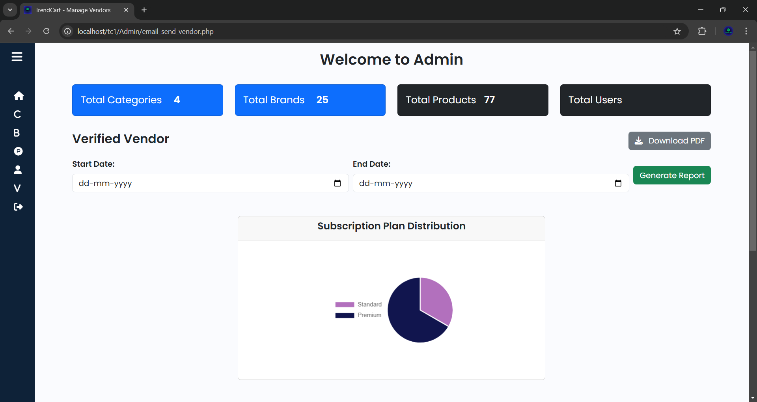

Slide 50
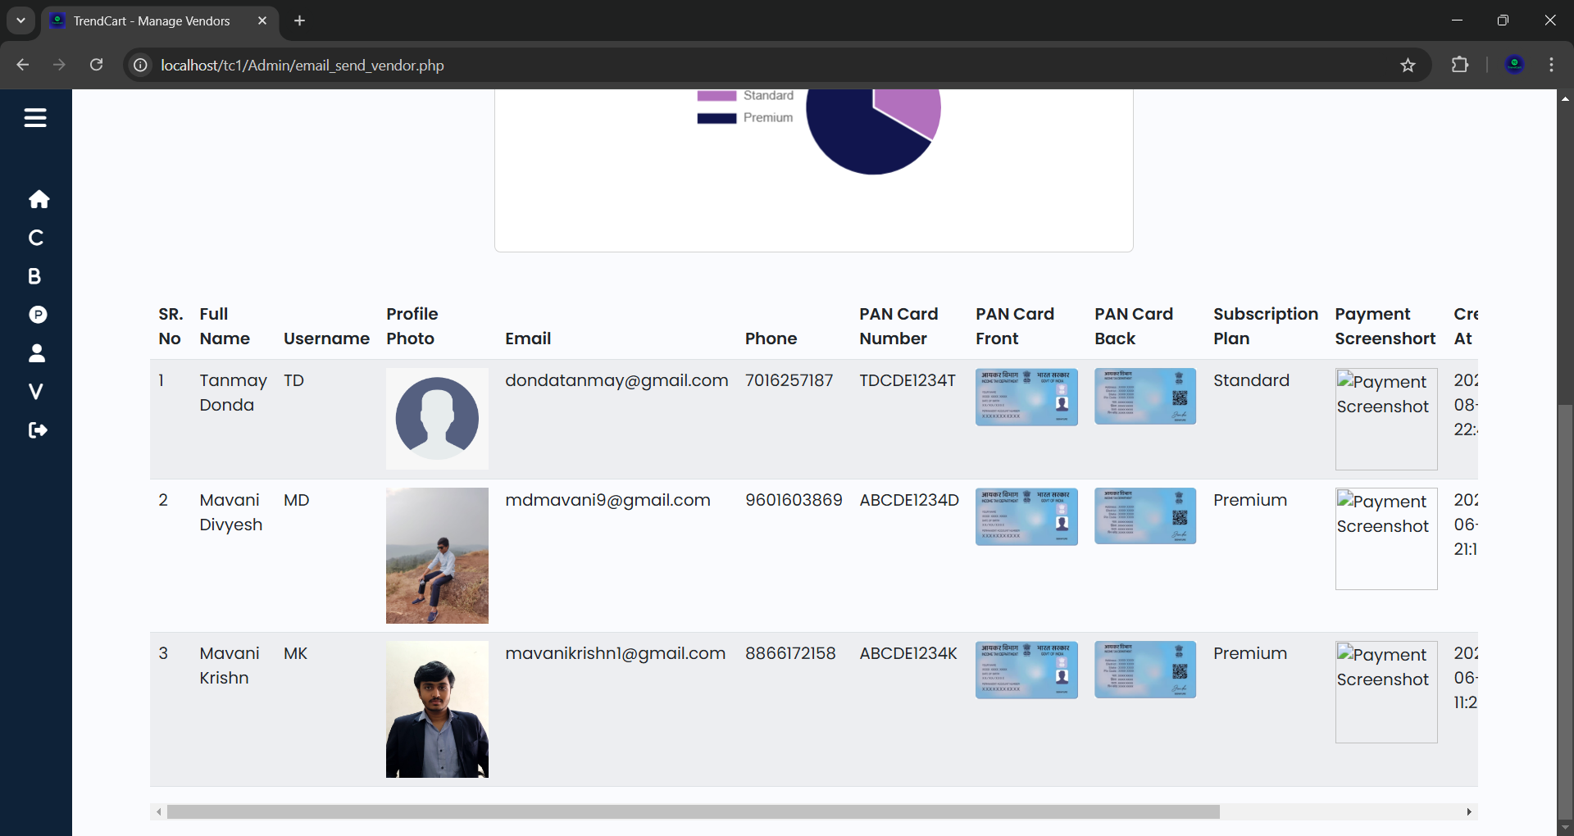
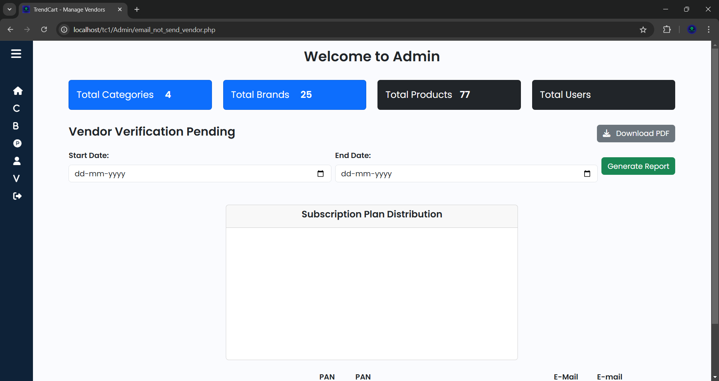

Slide 51
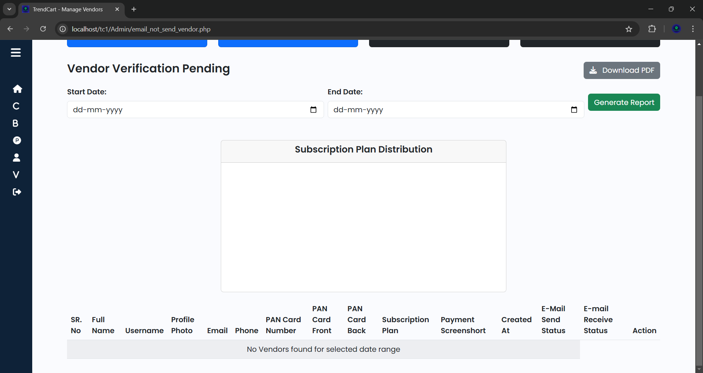

Slide 52



Slide 53



Slide 54

Vendor Home Page

Slide 55




Vendor Register Form

Slide 56





Slide 57



Slide 58



Slide 59



Slide 60



Slide 61



Slide 62



Slide 63


Slide 64



Slide 65


Slide 66



Slide 67



Slide 68



Slide 69


Slide 70
Vendor Login Form

Slide 71
Vendor Forgot Password

Slide 72


Slide 73


Vendor Dashboard

Slide 74


Add Products
Manage Products

Slide 75


Verification Pending Products
Verified Products

Slide 76
THANK YOU

